Slide 1


Frameworks in MEL
Mohammad Golam Kibria
HIS/M&E Advisor
MEASURE Evaluation
31 July 2018

Slide 2

Learning Objectives
Describe functions of frameworks in MEL
Describe results frameworks

Slide 3

Functions of Frameworks
Roadmaps to program planning, monitoring, and evaluation
Draw out clear pathways to program goals and objectives
Define relationships among program inputs, processes, outputs, outcomes, and impact
Describe how program factors interact with external context (environmental factors)
Lead to sound implementation and M&E plans

Slide 4
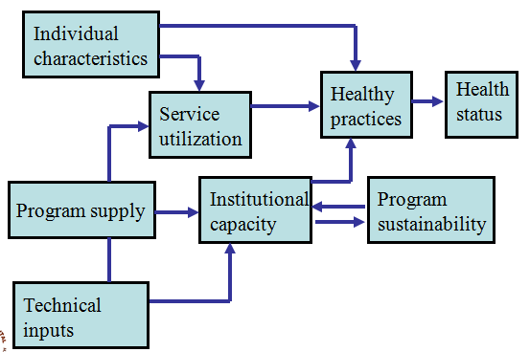
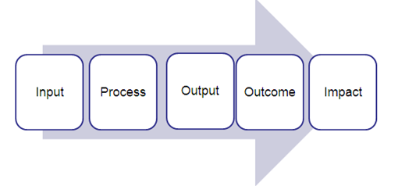
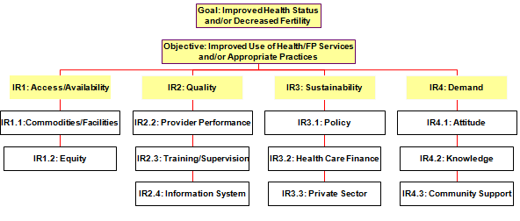
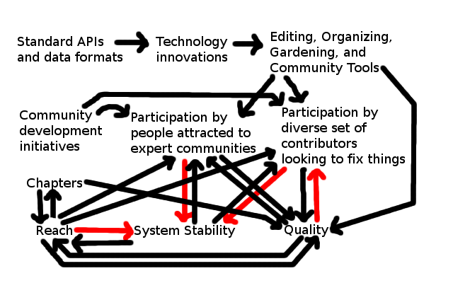
Types of Frameworks
Conceptual
Conceptual Framework
Log Model
Logic Model
Results Framework
Results Framework
Theory of Change
This Photo by Unknown Author is licensed under CC BY-SA

Slide 5
Summary of Framework
Type of framework | Brief description | Program management | Basis for monitoring and evaluation
Conceptual framework | Establish causal pathway and interaction of program and environmental factors | Determine which factors the program will influence | No, but can help to explain results
Logic model | Shows logical flow of inputs, process, outputs, outcome, impact | Helps in determining key program elements to be tracked | Yes, at all stages of the program from inputs to process to outputs to outcomes
Results framework | Logically linked program objectives | Shows the logical relationship between program goal, objectives and sub-objectives | Yes, at the objectives level
Theory of change | Combines elements of a conceptual framework and logic model | Shows the causal relationship between activities, outcomes, and impact; and with external factors | Yes, at all stages of program

Slide 6
Results Framework
Definition
  A tabular/graphic description of a program’s strategy for achieving a specific strategic objective (SO) through intermediate results, with a narrative supplement
Purpose
  Like a logic framework, a results framework is a planning & management tool for programs
  Specifies exactly how, through a set of intermediate results, the program’s SO will be achieved
  Provides a basis of consensus for all program stakeholders
  Conveys the development hypothesis—plausible linkages between the intermediate results and the SO
¹USAID, Performance Monitoring and Evaluation TIPS: Building a Results Framework, PN-ACA-947

Slide 7
Results Framework Components
Strategic objective
  The ultimate end point of the results framework—the goal of the program
  “Standard by which the operational unit (performance) is willing to be judged”
  Appropriate level of ambition means the SO should be achievable, clear, and measurable
Intermediate results
  Achievable in the short term; lower level than SO
  An intermediate step leading to achieving the SO
  Lower level of impact than the SO; cumulative effect leads to the SO
¹USAID, Performance Monitoring and Evaluation TIPS: Building a Results Framework, PN-ACA-947

Slide 8
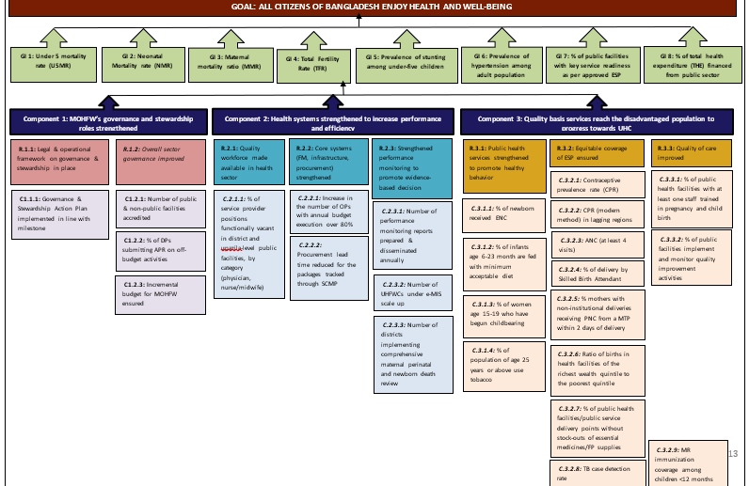
4th HPNSP Results Framework (RFW)

Slide 9
This presentation was produced with the support of the United States Agency for International Development (USAID) under the terms of MEASURE Evaluation cooperative agreement AID-OAA-L-14-00004. MEASURE Evaluation is implemented by the Carolina Population Center, University of North Carolina at Chapel Hill in partnership with ICF International; John Snow, Inc.; Management Sciences for Health; Palladium; and Tulane University. Views expressed are not necessarily those of USAID or the United States government.
www.measureevaluation.org

