Slide 1
Role of HIS in Program Monitoring
Mohammad Golam Kibria
HIS/M&E Advisor
MEASURE Evaluation
31 July 2018

Slide 2
At the end of this session, participants will be able to:
Name the main information sources for monitoring and evaluation (M&E) of Health programs
Understand the data quality dimensions and tools
Understand the role of information in Monitoring Programs

Slide 3
Health Information System: Data Sources
(HMN, 2008)
Census
Resource
records systems
Vital
registration
Services records systems
Pop based
surveys
Individual
Records systems
Population-based
data sources
Facility- and community-based
information systems--also called
routine health information
systems (RHIS)
Notes:
HIS can be subdivided in population-based data sources and facility and community-based data sources (HMN, 2008).
Another way to categorize health information system (HIS) subsystems is based on the frequency of data collection.
Routine data collection refers to data that are collected continuously, with processing and reporting more often than annually. Routine health information systems (RHIS) are facility-based and community-based subsystems that collect routine information on patients as they use services. Vital registration is routine data collection on vital events (births, deaths, and migration data) and occurs mostly outside the health system.
Nonroutine data collection refers to data that are collected on a periodic basis. The periodicity is usually less frequent than annually. Examples of nonroutine data sources are household surveys and a national census. Research might also be a data source; the experimental design may require continuous data collection with the findings reported at the end, or perhaps following a mid-experiment review of the data.
This class focuses on RHIS data.

Slide 4
Constraints to Using Data in Decision Making in Health
Insufficient access to data
Poor data quality
Insufficient institutional support for data collection and use
Insufficient skills to analyze, interpret and use data
Intuition-based decision making
Lack of coordination
Inadequate ICT infrastructure
Lack of incentive
Lack of integration/interoperability (HMIS-LMIS)
Weak feedback mechanism and data governance
Behavioral factors (e.g. Motivation)
Notes:
The end goal is a data-driven culture where everyone sees the value in data, understands the importance of collecting good data, has access to the data, and uses the data to support decision-making.

Slide 5
Routine Health Information System- Indicators
ANC coverage (at least 4 visits)
Institutional birth
Number of districts submitting performance monitoring report through DHIS 2
Notification of New TB case
Enrolment of MDR patients for treatment (cumulative)
Outpatient consultations in GoB facilitates
Percentage of targeted public health facilities meeting readiness criteria for delivery of PPFP services
Percentage of health facilities visited quarterly by Quality Improvement Team (QIT) for Quality LARC & PM Service

Slide 6
What Is Data Quality and Data Quality Assurance?
Data Quality:
Data quality is often defined as “fitness for use.”
What does this mean?
Data are fit for their intended uses in operations, decision making, and planning.
Data reflect real value or true performance.
Data meet reasonable standards when checked against criteria for quality.
Data Quality Assurance:
A systematic monitoring and evaluation of data to uncover inconsistencies in the data and data management system, and making necessary corrections to ensure quality of data

Slide 7
Importance of Data Quality
High-quality data help providers and managers:
  Form an accurate picture of health needs, programs, and services in specific areas
  Inform appropriate planning and decision making (such as staffing requirements and planning healthcare services)
  Inform effective and efficient allocation of resources
  Support ongoing monitoring, by identifying best practices and areas where support and corrective measures are needed

Slide 8
Data Quality Dimensions
Validity | Valid data are considered accurate Measure what they are intended to measure
Reliability | The data are measured and collected consistently
Completeness | Completely inclusive: an information system represents the complete list of eligible names and not a fraction of the list
Precision | The data have sufficient detail
Timeliness | Data are up-to-date (current), and information is available on time
Integrity | The data are protected from deliberate bias or manipulation for political or personal reasons

Slide 9
Data Quality Issues:
Observed issues with SmPR 2017:
Timeliness- Delayed submission of report
Precision- Lack of sufficient details in physical progress
Completeness- Unavailability of gender disaggregated data
Indicator analysis- NA (Not Applicable OR Not Available)
Inconsistency across physical progress, indicator achievements, training, challenge encountered etc.
Recommendations for APIR 2018:
Adhere to timeline set by PMMU
Consistency among the indicator achievements, physical progress and undertaken training activities
Detailed description of the progress with some key achievements and mention associated challenges
Level-wise and gender-disaggregated training data
Reporting consistency on the overlapping DLI and OP-level indicators
Careful about more indicators, less physical progress

Slide 10
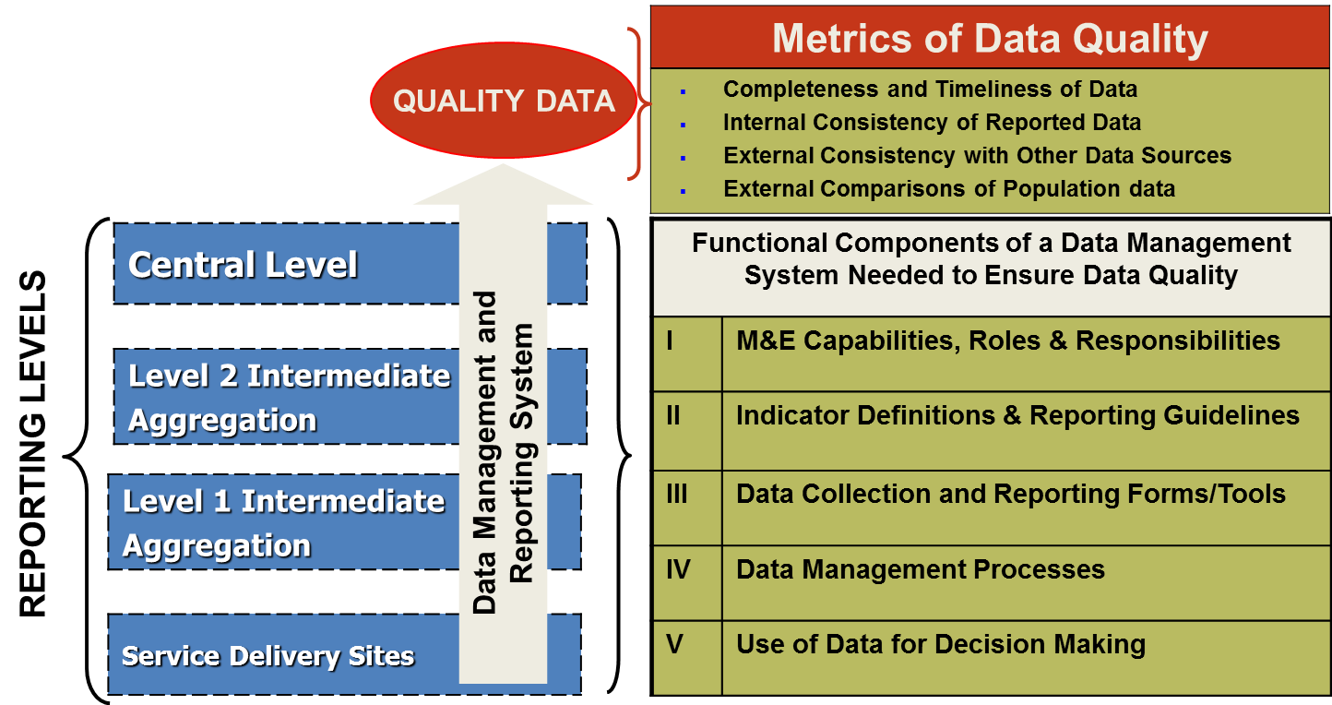
Metrics of Data Quality
Completeness and Timeliness of Data: Availability of reports and availability of complete data (up-to-date, available on time, and found to be correct)
Internal Consistency of Reported Data: Plausibility of reported results, trends over time, and consistency between related indicators and potential outliers
External Consistency with Other Data Sources: Level of agreement between two sources of data measuring the same health indicator
External Comparisons of Population Data: Consistency between denominators from different sources used to calculate health indicators

Slide 11
Data Quality Improvement Tools
Tools | Description
On-site data verification (OSDV) | Spot-checks of delivery of services and/or commodities; Cross-verification of programmatic data with other sources; Re-aggregation of data from primary records and comparison with results
Data quality audits (DQA) | Provide an in-depth assessment of data quality and M&E systems; Provides how-to protocols and methodologies for solving data quality issues
Routine data quality audits (RDQA) | simplified version of DQA; rapidly assess the quality of their data and strengthen their data management and reporting systems
M&E system strengthening tool and 12 Components | Periodic assessments of M&E system to review the implementation of national M&E plan

Slide 12
Data Verification Example
Projection Accuracy (National vs Local)
CPR vs Contraceptive Acceptance Rate (% variation accepted - up to 15%)
HMIS vs LMIS

Slide 13
RHIS Linkage Examples
Linking HMIS with a census
  Coverage rates
Linking logistics management information systems (LMIS) and HMIS:
  Relationship between stockouts and services
  Composite indicators, such as couple years of protection (CYP)
Linking human resource information systems (HRIS) and HMIS
  Workload analysis (patient visits per doctor)

Slide 14
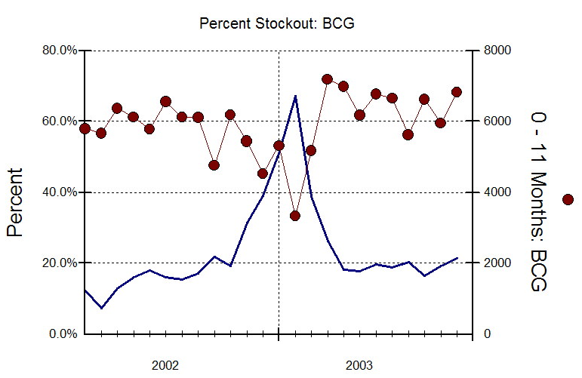
Linking LMIS and HMIS Data for Improved Use of Information
Before: Vaccine stockouts went unreported
After: Tracked relationship between stockouts and children vaccinated
Evidence of elevated stockout percentage and lower number of children vaccinated alerted MOH to request additional vaccines from donors.
Notes:
The Eritrea National Health Management Information System (NHMIS) is an integrated, decentralized information system that includes data on vaccine stocks as well as the number of children vaccinated. Vaccine stockouts are calculated as 0 vaccines available at the end of the month. The NHMIS was an important tool that allowed the Eritrean Ministry of Health to locate facilities with stockout problems. The graph here shows the relationship between stockouts and children vaccinated.

Slide 15
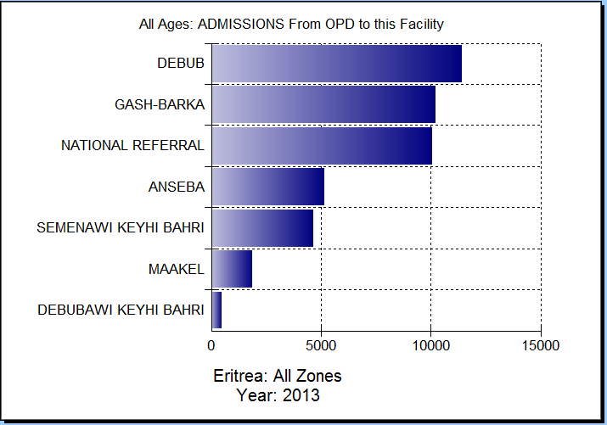
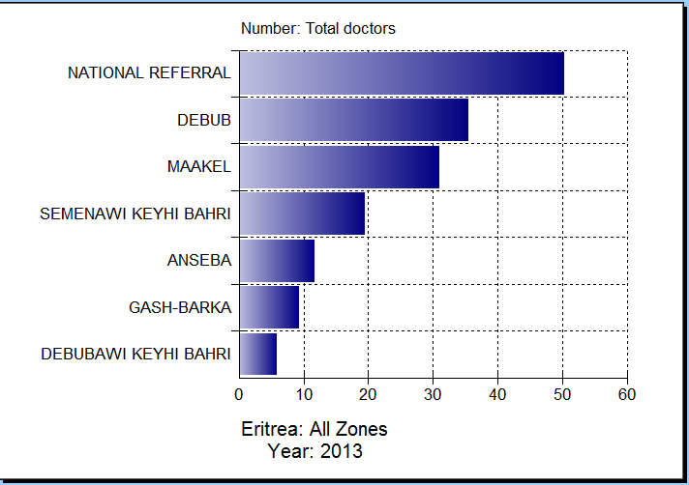
Linking LMIS and HMIS Data for Improved Use of Information

Slide 16
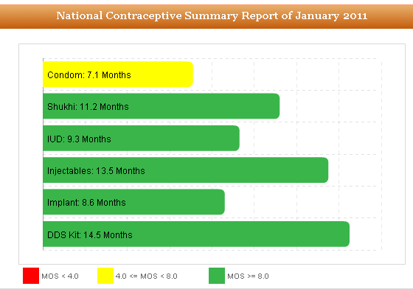
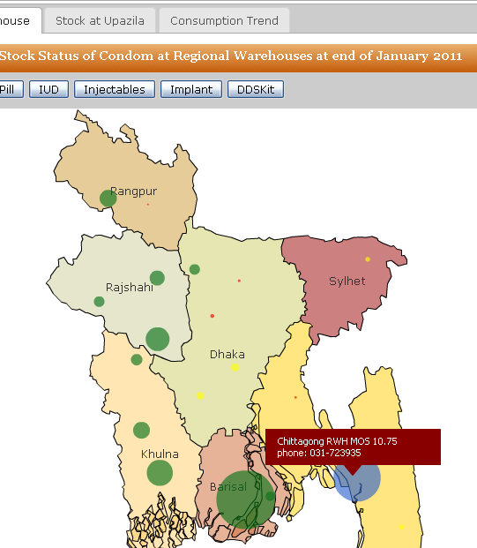
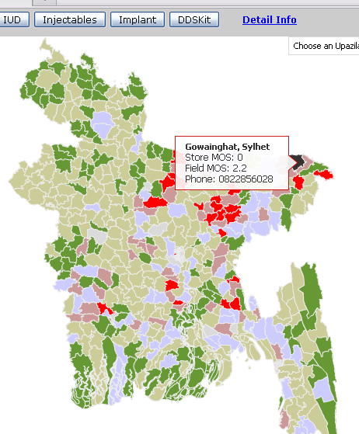
Family Planning Stock Monitoring at Different Levels

Slide 17
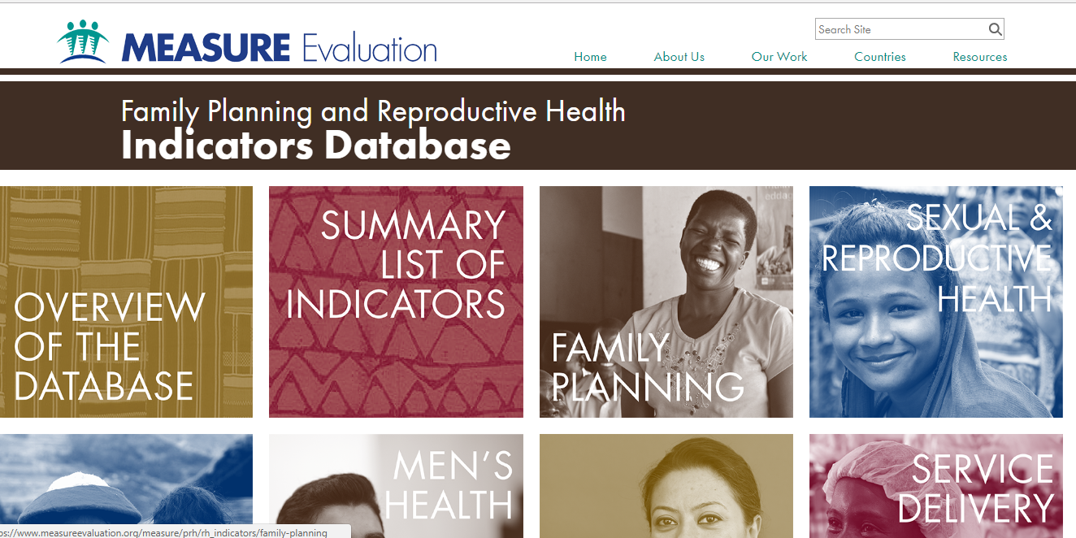
Live Demo- https://www.measureevaluation.org/

Slide 18
Thanks!!!
kibria@email.unc.edu
Acknowledgement: USAID funded MEASURE Evaluation, WHO, MSH/SIAPS, icddrb, Save the children

